Slide 1
CSP571 Data Preparation and Analysis
Lecture 14. Midterm Overview
Oleksandr Narykov
onarykov@iit.edu

Slide 2
Midterm. Written Part
Q1. You have the following dataset:
X | Y
2 | 1
3 | 4
5 | 7
Use closed-form matrix equation to compute linear regression coefficients.
23

Slide 3
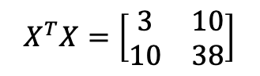
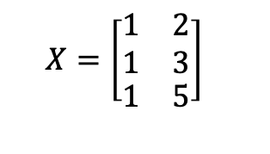
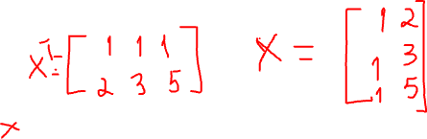
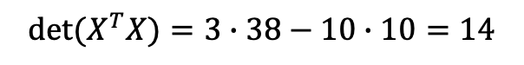
Midterm. Written Part
Q1. You have the following dataset:
$$X=\left[\begin{matrix}\begin{matrix}1 \\ 1\end{matrix} & \begin{matrix}2 \\ 3\end{matrix} \\ 1 & 5\end{matrix}\right]$$
$$X^{T}X=\left[\begin{matrix}3 & 10 \\ 10 & 38\end{matrix}\right]$$
$${det⁡(X}^{T}X)=3∙38−10∙10=14$$
23

Slide 4
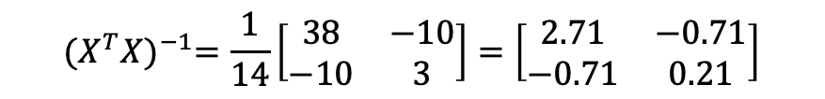
Midterm. Written Part
Q1. You have the following dataset:
$$X=\left[\begin{matrix}\begin{matrix}1 \\ 1\end{matrix} & \begin{matrix}2 \\ 3\end{matrix} \\ 1 & 5\end{matrix}\right]$$
$$X^{T}X=\left[\begin{matrix}3 & 10 \\ 10 & 38\end{matrix}\right]$$
$${det⁡(X}^{T}X)=3∙38−10∙10=14$$
$${(X^{T}X)}^{−1}=\frac{1}{14}\left[\begin{matrix}38 & −10 \\ −10 & 3\end{matrix}\right]=\left[\begin{matrix}2.71 & −0.71 \\ −0.71 & 0.21\end{matrix}\right]$$
23

Slide 5


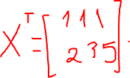
Midterm. Written Part
Q1. You have the following dataset:
$$X=\left[\begin{matrix}\begin{matrix}1 \\ 1\end{matrix} & \begin{matrix}2 \\ 3\end{matrix} \\ 1 & 5\end{matrix}\right]$$
$$Y=\left[\begin{matrix}1 \\ 4 \\ 7\end{matrix}\right]$$
$$X^{T}X=\left[\begin{matrix}3 & 10 \\ 10 & 38\end{matrix}\right]$$
$${det⁡(X}^{T}X)=3∙38−10∙10=14$$
$${(X^{T}X)}^{−1}=\frac{1}{14}\left[\begin{matrix}38 & −10 \\ −10 & 3\end{matrix}\right]=\left[\begin{matrix}2.71 & −0.71 \\ −0.71 & 0.21\end{matrix}\right]$$
$$X^{T}Y=\left[\begin{matrix}12 \\ 49\end{matrix}\right]$$
23

Slide 6

Midterm. Written Part
Q1. You have the following dataset:
$$X=\left[\begin{matrix}\begin{matrix}1 \\ 1\end{matrix} & \begin{matrix}2 \\ 3\end{matrix} \\ 1 & 5\end{matrix}\right]$$
$$X^{T}X=\left[\begin{matrix}3 & 10 \\ 10 & 38\end{matrix}\right]$$
$${det⁡(X}^{T}X)=3∙38−10∙10=14$$
$${(X^{T}X)}^{−1}=\frac{1}{14}\left[\begin{matrix}38 & −10 \\ −10 & 3\end{matrix}\right]=\left[\begin{matrix}2.71 & −0.71 \\ −0.71 & 0.21\end{matrix}\right]$$
$$X^{T}Y=\left[\begin{matrix}12 \\ 49\end{matrix}\right]$$
$$w={(X^{T}X)}^{−1}X^{T}Y=\left[\begin{matrix}−2.27 \\ 1.77\end{matrix}\right]$$
23

Slide 7
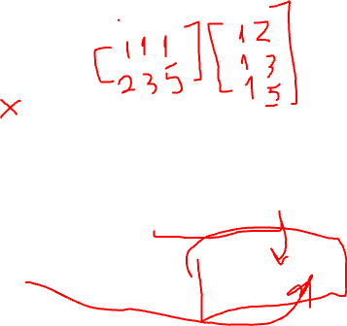
Midterm. Written Part
Q1. You have the following dataset:
$$X=\left[\begin{matrix}\begin{matrix}1 \\ 1\end{matrix} & \begin{matrix}2 \\ 3\end{matrix} \\ 1 & 5\end{matrix}\right]$$
$$X^{T}X=\left[\begin{matrix}3 & 10 \\ 10 & 38\end{matrix}\right]$$
$${det⁡(X}^{T}X)=3∙38−10∙10=14$$
$${(X^{T}X)}^{−1}=\frac{1}{14}\left[\begin{matrix}38 & −10 \\ −10 & 3\end{matrix}\right]=\left[\begin{matrix}2.71 & −0.71 \\ −0.71 & 0.21\end{matrix}\right]$$
$$X^{T}Y=\left[\begin{matrix}12 \\ 49\end{matrix}\right]$$
$$w={(X^{T}X)}^{−1}X^{T}Y=\left[\begin{matrix}−2.27 \\ 1.77\end{matrix}\right]$$
23

Slide 8
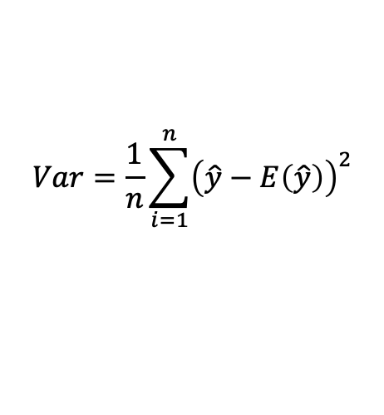
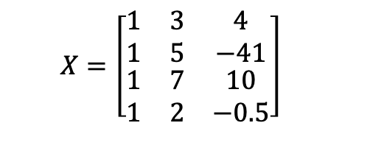
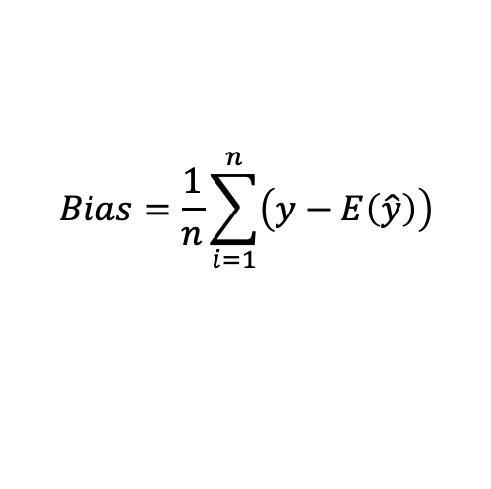
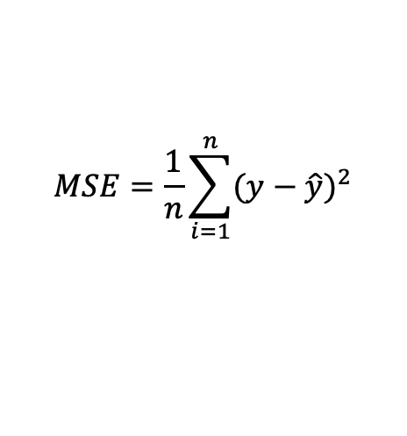
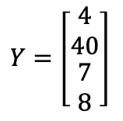
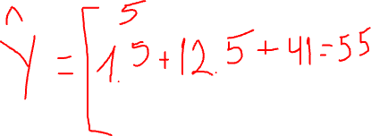

Midterm
Q2. For a model with a given weights estimate bias, variance, and MSE on a following dataset :
$$Bias=\frac{1}{n}\sum_{i=1}^{n}{\left(y−E\left(\hat{y}\right)\right)}$$
$$X=\left[\begin{matrix}1 & 3 & 4 \\ 1 & 5 & −41 \\ \begin{matrix}1 \\ 1\end{matrix} & \begin{matrix}7 \\ 2\end{matrix} & \begin{matrix}10 \\ −0.5\end{matrix}\end{matrix}\right]$$
$$Y=\left[\begin{matrix}4 \\ 40 \\ \begin{matrix}7 \\ 8\end{matrix}\end{matrix}\right]$$
$$w=\left[\begin{matrix}1.5 \\ \begin{matrix}2.5 \\ −1\end{matrix}\end{matrix}\right]$$
$$Var=\frac{1}{n}\sum_{i=1}^{n}{{\left(\hat{y}−E\left(\hat{y}\right)\right)}^{2}}$$
$$MSE=\frac{1}{n}\sum_{i=1}^{n}{{(y−\hat{y})}^{2}}$$
23

Slide 9
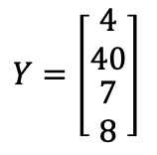
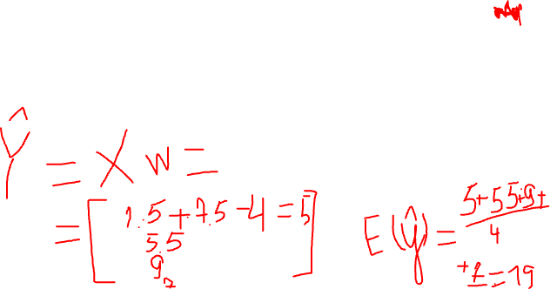
Midterm
Q2. For a model with a given weights estimate bias, variance, and MSE on a following dataset :
$$Bias=\frac{1}{n}\sum_{i=1}^{n}{\left(y−E\left(\hat{y}\right)\right)}$$
$$X=\left[\begin{matrix}1 & 3 & 4 \\ 1 & 5 & −41 \\ \begin{matrix}1 \\ 1\end{matrix} & \begin{matrix}7 \\ 2\end{matrix} & \begin{matrix}10 \\ −0.5\end{matrix}\end{matrix}\right]$$
$$Y=\left[\begin{matrix}4 \\ 40 \\ \begin{matrix}7 \\ 8\end{matrix}\end{matrix}\right]$$
$$w=\left[\begin{matrix}1.5 \\ \begin{matrix}2.5 \\ −1\end{matrix}\end{matrix}\right]$$
$$Var=\frac{1}{n}\sum_{i=1}^{n}{{\left(\hat{y}−E\left(\hat{y}\right)\right)}^{2}}$$
$$MSE=\frac{1}{n}\sum_{i=1}^{n}{{(y−\hat{y})}^{2}}$$
23

Slide 10
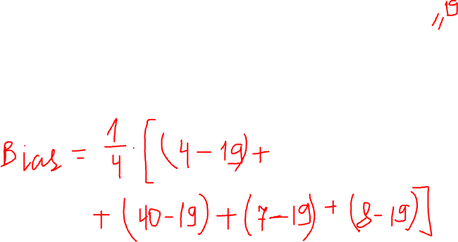
Midterm
Q2. For a model with a given weights estimate bias, variance, and MSE on a following dataset :
$$Bias=\frac{1}{n}\sum_{i=1}^{n}{\left(y−E\left(\hat{y}\right)\right)}$$
$$X=\left[\begin{matrix}1 & 3 & 4 \\ 1 & 5 & −41 \\ \begin{matrix}1 \\ 1\end{matrix} & \begin{matrix}7 \\ 2\end{matrix} & \begin{matrix}10 \\ −0.5\end{matrix}\end{matrix}\right]$$
$$Y=\left[\begin{matrix}4 \\ 40 \\ \begin{matrix}7 \\ 8\end{matrix}\end{matrix}\right]$$
$$w=\left[\begin{matrix}1.5 \\ \begin{matrix}2.5 \\ −1\end{matrix}\end{matrix}\right]$$
$$Var=\frac{1}{n}\sum_{i=1}^{n}{{\left(\hat{y}−E\left(\hat{y}\right)\right)}^{2}}$$
$$MSE=\frac{1}{n}\sum_{i=1}^{n}{{(y−\hat{y})}^{2}}$$
23

Slide 11
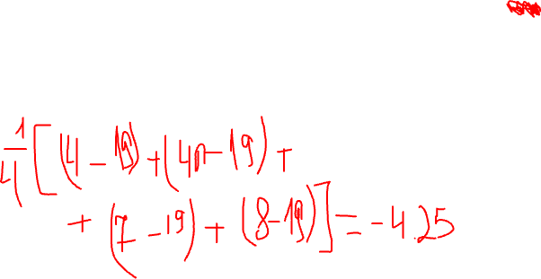
Midterm
Q2. For a model with a given weights estimate bias, variance, and MSE on a following dataset :
$$Bias=\frac{1}{n}\sum_{i=1}^{n}{\left(y−E\left(\hat{y}\right)\right)}$$
$$X=\left[\begin{matrix}1 & 3 & 4 \\ 1 & 5 & −41 \\ \begin{matrix}1 \\ 1\end{matrix} & \begin{matrix}7 \\ 2\end{matrix} & \begin{matrix}10 \\ −0.5\end{matrix}\end{matrix}\right]$$
$$Y=\left[\begin{matrix}4 \\ 40 \\ \begin{matrix}7 \\ 8\end{matrix}\end{matrix}\right]$$
$$w=\left[\begin{matrix}1.5 \\ \begin{matrix}2.5 \\ −1\end{matrix}\end{matrix}\right]$$
$$Var=\frac{1}{n}\sum_{i=1}^{n}{{\left(\hat{y}−E\left(\hat{y}\right)\right)}^{2}}$$
$$MSE=\frac{1}{n}\sum_{i=1}^{n}{{(y−\hat{y})}^{2}}$$
23

Slide 12
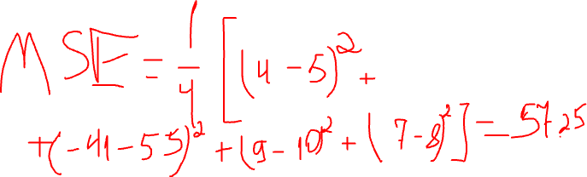
Midterm
Q2. For a model with a given weights estimate bias, variance, and MSE on a following dataset :
$$Bias=\frac{1}{n}\sum_{i=1}^{n}{\left(y−E\left(\hat{y}\right)\right)}$$
$$X=\left[\begin{matrix}1 & 3 & 4 \\ 1 & 5 & −41 \\ \begin{matrix}1 \\ 1\end{matrix} & \begin{matrix}7 \\ 2\end{matrix} & \begin{matrix}10 \\ −0.5\end{matrix}\end{matrix}\right]$$
$$Y=\left[\begin{matrix}4 \\ 40 \\ \begin{matrix}7 \\ 8\end{matrix}\end{matrix}\right]$$
$$w=\left[\begin{matrix}1.5 \\ \begin{matrix}2.5 \\ −1\end{matrix}\end{matrix}\right]$$
$$Var=\frac{1}{n}\sum_{i=1}^{n}{{\left(\hat{y}−E\left(\hat{y}\right)\right)}^{2}}$$
$$MSE=\frac{1}{n}\sum_{i=1}^{n}{{(y−\hat{y})}^{2}}$$
23

Slide 13
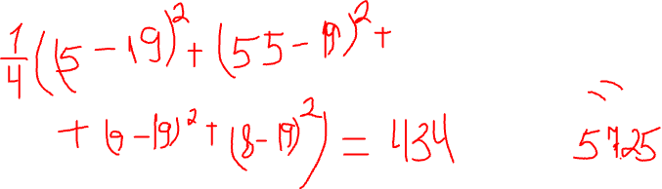
Midterm
Q2. For a model with a given weights estimate bias, variance, and MSE on a following dataset :
$$Bias=\frac{1}{n}\sum_{i=1}^{n}{\left(y−E\left(\hat{y}\right)\right)}$$
$$X=\left[\begin{matrix}1 & 3 & 4 \\ 1 & 5 & −41 \\ \begin{matrix}1 \\ 1\end{matrix} & \begin{matrix}7 \\ 2\end{matrix} & \begin{matrix}10 \\ −0.5\end{matrix}\end{matrix}\right]$$
$$Y=\left[\begin{matrix}4 \\ 40 \\ \begin{matrix}7 \\ 8\end{matrix}\end{matrix}\right]$$
$$w=\left[\begin{matrix}1.5 \\ \begin{matrix}2.5 \\ −1\end{matrix}\end{matrix}\right]$$
$$Var=\frac{1}{n}\sum_{i=1}^{n}{{\left(\hat{y}−E\left(\hat{y}\right)\right)}^{2}}$$
$$MSE=\frac{1}{n}\sum_{i=1}^{n}{{(y−\hat{y})}^{2}}$$
23

Slide 14
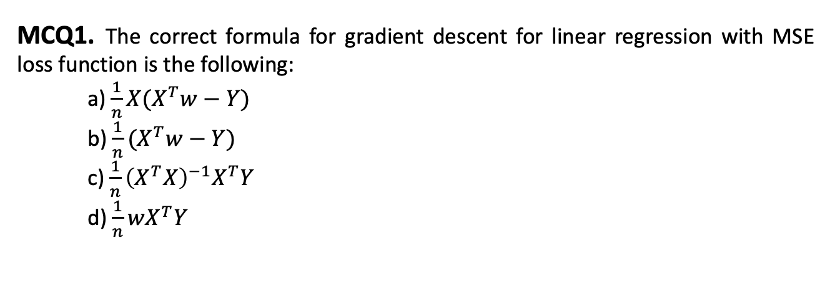
Midterm
MCQ1. The correct formula for gradient descent for linear regression with MSE loss function is the following:
a) $\frac{1}{n}X(X^{T}w−Y)$
b) $\frac{1}{n}(X^{T}w−Y)$
c) $\frac{1}{n}{\left(X^{T}X\right)}^{−1}X^{T}Y$
d) $\frac{1}{n}wX^{T}Y$
23

Slide 15
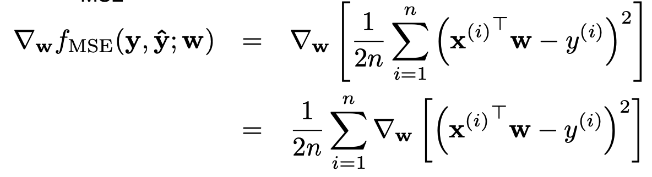
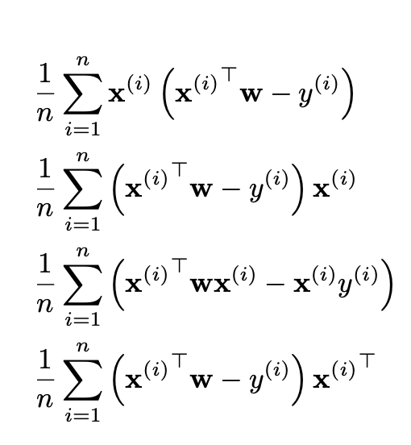
Midterm
23

Slide 16
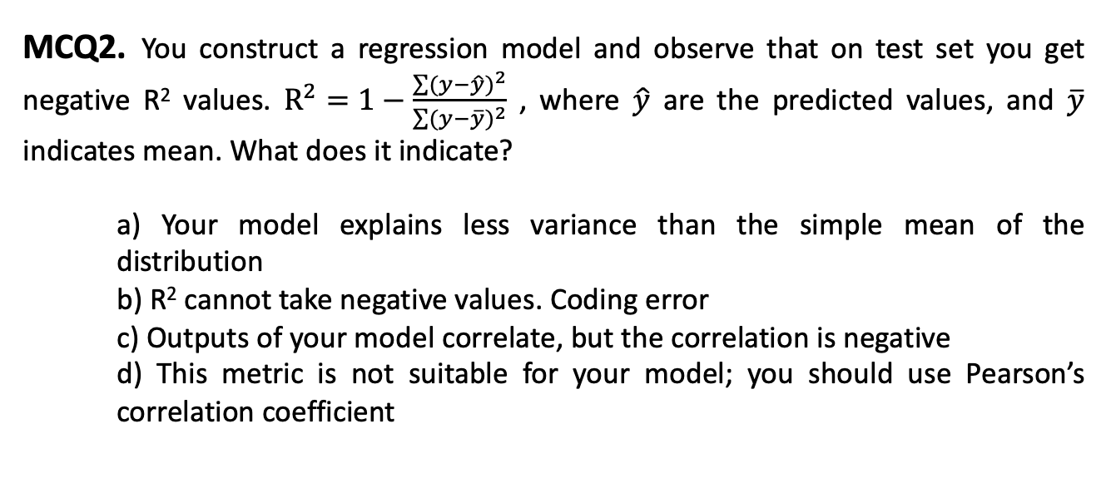
Midterm
MCQ2. You construct a regression model and observe that on test set you get negative R² values. $R^{2}=1−\frac{\sum{{(y−\hat{y})}^{2}}}{\sum{{(y−\overline{y})}^{2}}}$ , where $\hat{y}$ are the predicted values, and $\overline{y}$ indicates mean. What does it indicate?
a) Your model explains less variance than the simple mean of the distribution
b) R² cannot take negative values. Coding error
c) Outputs of your model correlate, but the correlation is negative
d) This metric is not suitable for your model; you should use Pearson’s correlation coefficient
23

Slide 17
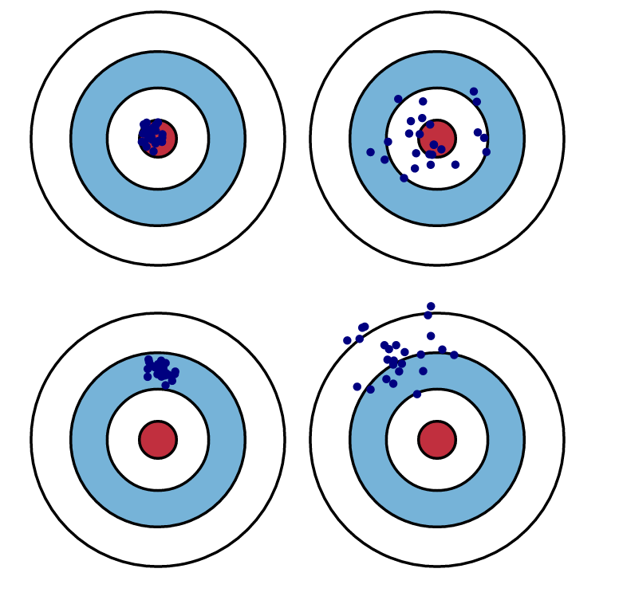
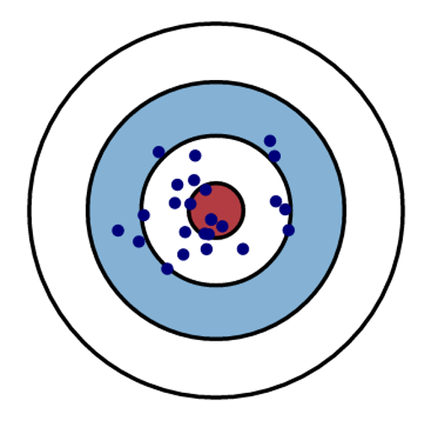
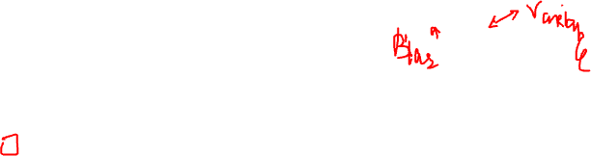
Midterm
MCQ3. Let’s consider model performance analogous to shooting practice, with bullseye being correct prediction and everything else being deviation. In terms of bias and variance, what are the characteristics of this model?
a) High bias, high variance
b) Low bias, low variance
c) Low bias, high variance
d) High bias, low variance
23

Slide 18
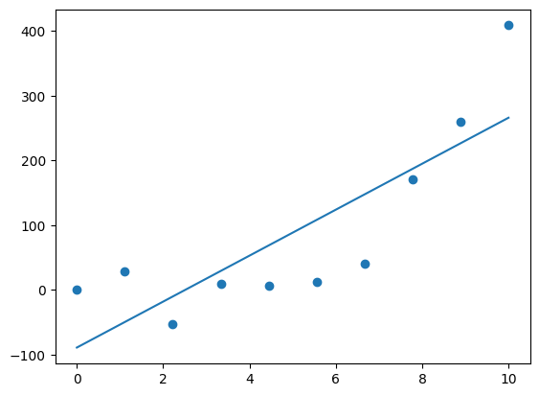
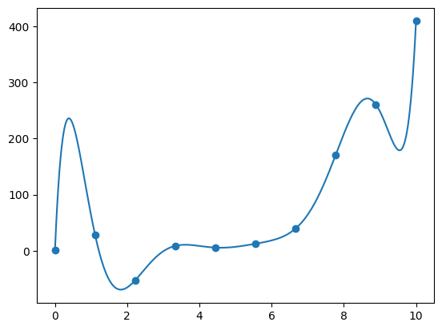
Bias / Variance Tradeoff
Making strong assumptions
Simple model
Underfitting
Allowing model to infer lots
of interdependencies in data
Very complex model
Overfitting
High Bias
High Variance

Slide 19
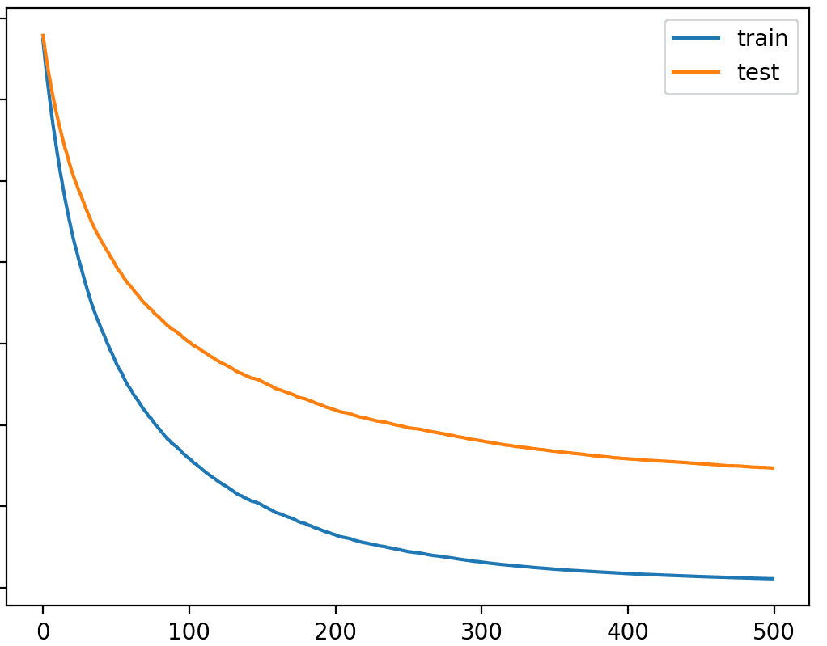
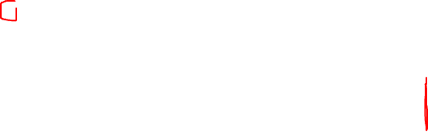
Midterm
MCQ4. You are presented with the following learning curve that indicates loss function. Remember bias / variance tradeoff charts. Y depicts loss, and X indicates model’s complexity. Which characteristics can you attribute to the model in figure at the complexity level 500?
a) Overfitting
b) Underfitting
c) Optimal value
d) Variance
23

Slide 20
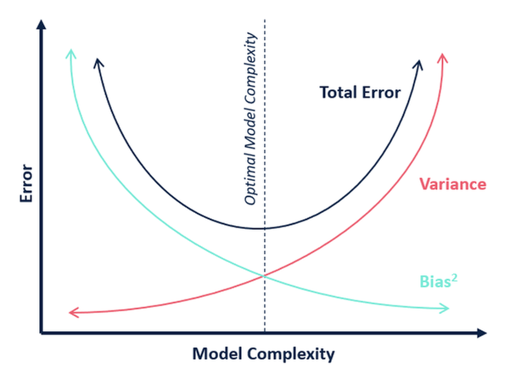
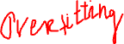
Bias / Variance Tradeoff

Slide 21
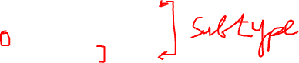
Midterm
MCQ5. Your dataset contains multiple classes and is highly imbalanced, but you want to achieve reasonably high performance on all classes. Which strategy would be the most appropriate option for cross-validation?
a) Random split
b) Grouped cross-validation
c) Stratified cross-validation
d) 60/20/20 split
23

Slide 22
Cross-Validation
Split your data into k disjoint sets
Each time, one set is the test set and the rest is the training set
Training Set
Test Set
Validation Set

Slide 23
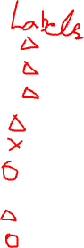
Grouped Cross-Validation
Split your data into k folds based on a group information
No samples from the same group is present both in test and train sets
Sample 1
Group 1
Sample 2
Sample 3
Sample 4
Group 2
Test Set
Sample 5
Group 3
Sample 6
Sample 7
Group 4
Sample 8

Slide 24
Imbalanced Dataset
Dataset
Stratified CV
Follows class distribution in the dataset
Weighted sampling
Increases importance of the drugs with smaller number of experiments
Stratified
Class 1
Class 2
Class 3
Weighted
Class 1
Class 2
Class 3

Slide 25
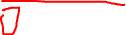
Midterm
MCQ6. Which technique allows for using the entire dataset for both training and testing?
a) Train-test split
b) Cross-validation
c) Hyperparameter tuning
d) Bootstrapping
23

Slide 26
Midterm
MCQ6. Which technique allows for using the entire dataset for both training and testing?
a) Train-test split
b) Cross-validation
c) Hyperparameter tuning
d) Bootstrapping
23
Notes:
B

Slide 27
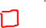
Midterm
MCQ7. What is the primary reason to use regularization in a regression model?
a) To increase the complexity of the model
b) To avoid overfitting by penalizing large coefficients
c) To reduce the bias of the model
d) To increase the variance in the model’s predictions
23
Notes:
B

Slide 28
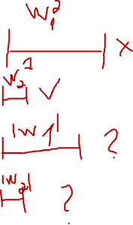
Regularization
L₂ regularization
Minimize squared-loss + L₂ penalty
Also called Ridge regression
L₁ regularization
Minimize squared-loss + L₁ penalty
Also called Lasso regression
11
Notes:
Square-shaped constraints
Rhombus-shaped constraints

Slide 29
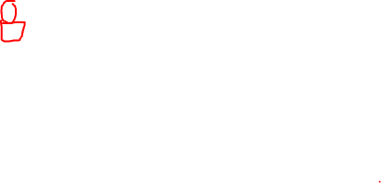
Midterm
MCQ8. What is the objective of L2 regularization in regression models?
a) Minimize squared loss without penalties
b) Minimize absolute loss and add a penalty term
c) Minimize squared loss with a penalty proportional to the sum of squared coefficients
d) Minimize loss based on feature selection
11
Notes:
C

Slide 30
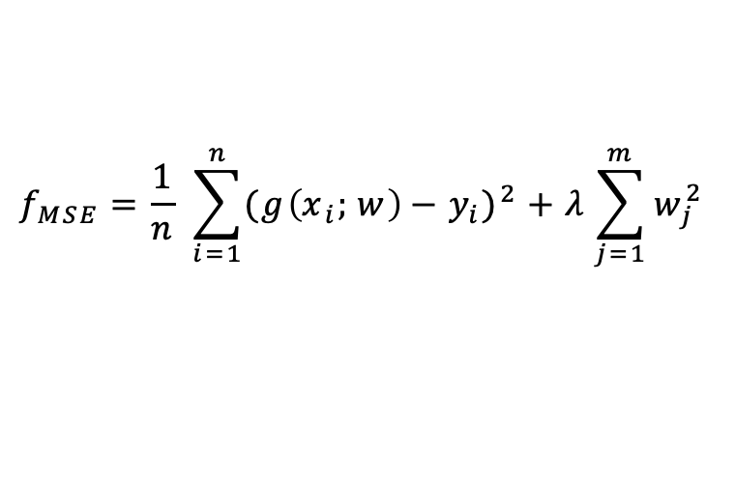
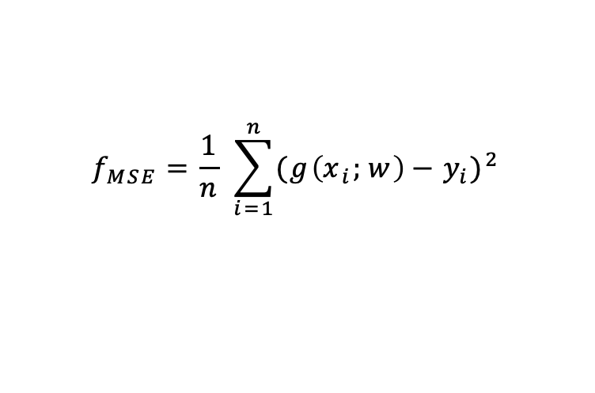
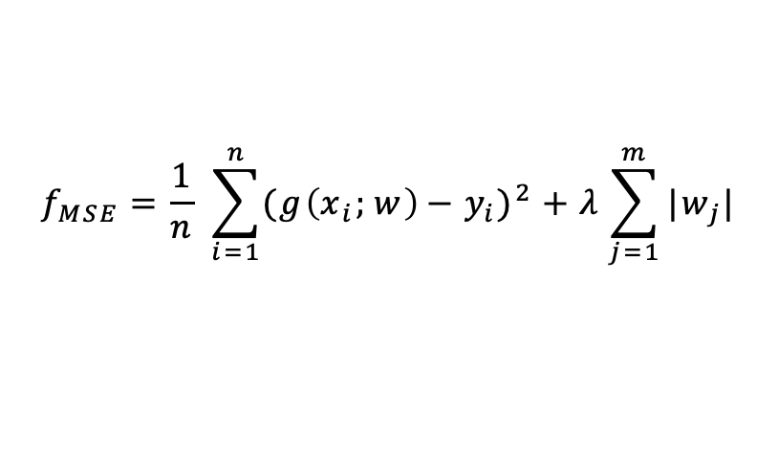
Regularization
$$f_{MSE}=\frac{1}{n} \sum_{i=1}^{n}{{({g\left(x_{i};w\right)−y}_{i})}^{2}}$$
L₂ regularization
$$f_{MSE}=\frac{1}{n} \sum_{i=1}^{n}{{({g\left(x_{i};w\right)−y}_{i})}^{2}}+λ\sum_{j=1}^{m}{w_{j}^{2}}$$
L₁ regularization
$$f_{MSE}=\frac{1}{n} \sum_{i=1}^{n}{{({g\left(x_{i};w\right)−y}_{i})}^{2}}+λ\sum_{j=1}^{m}{|w_{j}|}$$
11

Slide 31
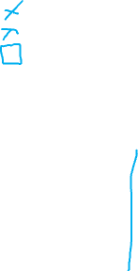
Midterm
MCQ9. Which of the following statements about the bias-variance tradeoff is correct?
a) High bias leads to overfitting.
b) High variance leads to underfitting.
c) High bias makes strong assumptions and leads to underfitting.
d) Reducing variance increases bias without affecting model complexity.
11
Notes:
C

Slide 32
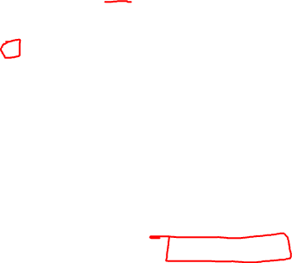
Midterm
MCQ10. What is a False Positive in classification problems?
a) Falsely classifying an object as negative when it is positive
b) Falsely classifying an object as positive when it is negative
c) Correctly classifying an object as positive
d) Correctly classifying an object as negative
 |  | Predicted Class
 |  | Positive | Negative
Actual Class | Positive | True Positive | False Negative
 | Negative | False Positive | True Negative
11
Notes:
B

Slide 33
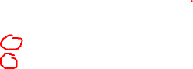
Midterm
MCQ11. What does the Area Under the Curve (AUC) represent in ROC analysis?
a) The probability that the model makes no errors
b) The proportion of true positives over false positives
c) The model’s ability to distinguish between classes
d) The ratio of true negatives to total actual negatives
11
Notes:
C

Slide 34
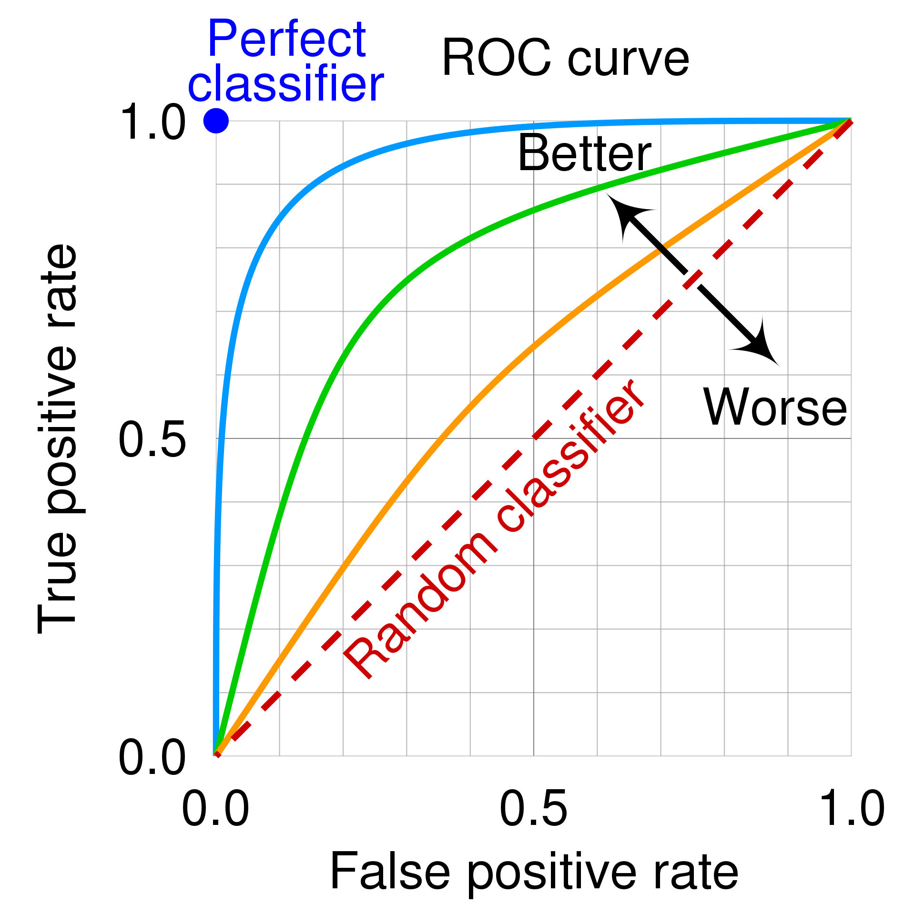
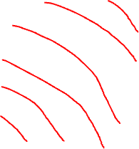
Area Under the Curve (AUC)
Area Under the Curve
What curve? ROC Curve
Receiving Operating Characteristic
The X axis is FPR
The Y axis is TPR
The curve is plotted by varying the “decision” threshold
15

Slide 35
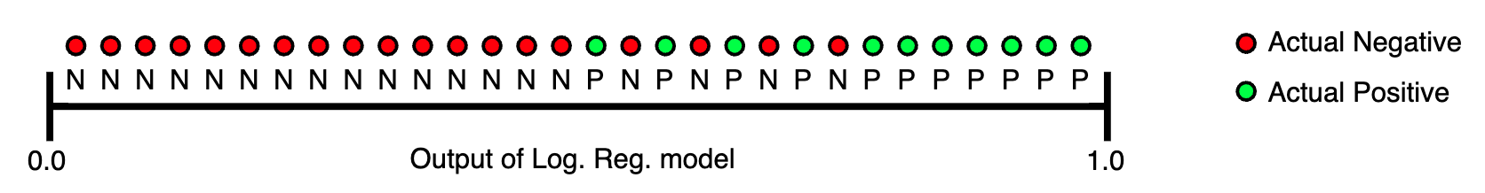
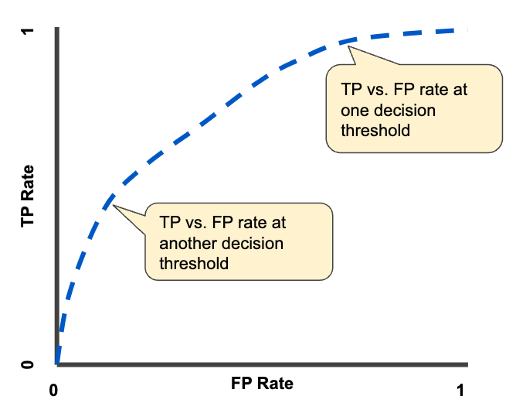
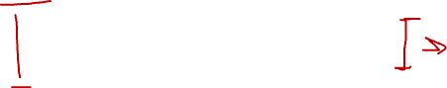
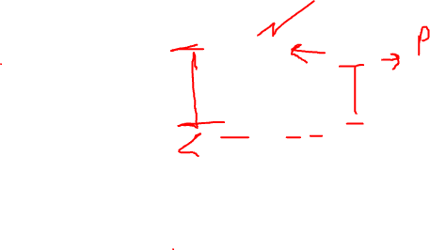
AUC Example
16

Slide 36
Midterm
MCQ12. Which measure is used to evaluate a model’s ability to detect positive cases?
a) Specificity
b) Recall
c) Precision
d) False Positive Rate
11
Notes:
B

Slide 37

Recall – True Positive Rate – Sensitivity
 |  | Predicted Class
 |  | Positive | Negative
Actual Class | Positive | True Positive | False Negative
 | Negative | False Positive | True Negative
𝑇𝑟𝑢𝑒 𝑃𝑜𝑠𝑖𝑡𝑖𝑣𝑒
𝑇𝑃
𝑇𝑃𝑅 = 𝑅𝑒𝑐𝑎𝑙𝑙 =
=
𝐴𝑐𝑡𝑢𝑎𝑙 𝑃𝑜𝑠𝑖𝑡𝑖𝑣𝑒
𝑇𝑃 + 𝐹𝑁
9

Slide 38
Midterm
MCQ13. What is a common limitation of accuracy as a metric in classification?
a) It gives too much importance to minority classes.
b) It cannot handle continuous data.
c) It is biased towards the majority class in imbalanced datasets.
d) It only works for binary classification.
Dataset
11
Notes:
C

Slide 39
Midterm
MCQ14. Which of the following is an example of data encoding in visualization?
a) Showing all data in a single color
b) Using different colors to represent different categories in the data
c) Displaying raw numbers without any visual aid
d) Ignoring the data structure
11
Notes:
B

Slide 40
Midterm
MCQ15. What is a crucial step to ensure the effectiveness of data visualization?
a) Using 3D visual components
b) Focusing mostly on aesthetic appeal
c) Validating the visualization by testing with actual users
d) Adding animation
11
Notes:
C

Slide 41
Midterm
MCQ16. Which of the following describes a mistake made in data visualization due to the wrong abstraction?
a) Showing incorrect labels
b) Using the wrong data to create the visualization
c) Displaying the correct data but with an ineffective visual representation
d) Using too much animation in the visual
11
Notes:
B

Slide 42

How to Validate?

Slide 43
Midterm
MCQ17. What is the main purpose of marks in data visualization?
a) To represent textual data
b) To encode information visually through shapes or lines
c) To enhance the aesthetics of a chart
d) To define the background color of a plot
11
Notes:
B

Slide 44
Midterm
MCQ17. What is the main purpose of marks in data visualization?
a) To represent textual data
b) To encode information visually through shapes or lines
c) To enhance the aesthetics of a chart
d) To define the background color of a plot
11
Notes:
B

Slide 45

Marks

Slide 46

Channels

Slide 47
Midterm
MCQ18. According to Weber’s Law, what do we use to judge differences in visual data?
a) Absolute differences
b) Relative differences
c) Visual complexity
d) Numerical labels
11
Notes:
B

Slide 48


Relative vs. Absolute
Weber's Law states that we judge based on relative, not absolute differences

Slide 49
Midterm
MCQ19. What is a common problem when using 3D visualizations for data representation?
a) 3D visualizations always improve clarity
b) They can represent inherently 3D objects
c) They can cause occlusion and distort information
d) They are easier to interpret than 2D plots
11
Notes:
B

Slide 50

Occlusion Hides Information

Slide 51


Perspective Distortion

Slide 52
Midterm
MCQ20. Which of the following visualization techniques is best suited for representing quantitative values?
a) Pie charts
b) Bar charts
c) Scatterplots
d) Line charts
11
Notes:
C, B

Slide 53
Midterm
MCQ21. Which of the following is a primary motivation for using dimensionality reduction in unsupervised learning?
a) To increase the complexity of the dataset
b) To remove irrelevant or redundant features
c) To improve the accuracy of supervised learning algorithms
d) To perform clustering
11
Notes:
B

Slide 54
Midterm
MCQ22. What is the primary objective of the K-Means clustering algorithm?
a) To minimize the variance within clusters
b) To maximize the distance between clusters
c) To assign data points to the most distant clusters
d) To reduce the number of features in the data
11
Notes:
A

Slide 55
K-Means
Basic idea: given data, find k prototype vectors, and assign each data point to its closest prototype vector, such that the sum of the distances to the closest prototype vectors is minimized
𝑁
𝑗=1
Let 𝐷 = 𝑥
𝑘
𝑖=1
be the data and let 𝑚
be the
𝑗
𝑖
prototype vectors. Objective:
minimize ∑^{𝑁} min 𝑑𝑖𝑠𝑡𝑎𝑛𝑐𝑒 𝑥_{𝑗}, 𝑚_{𝑖}
𝑗=1
𝑖
A typical distance metric is Euclidan distance
5

Slide 56

K-Means
Randomly initialized cluster centers
6

Slide 57

K-Means
Algorithm output after convergence (colors are changed)
6

Slide 58
Midterm
MCQ23. Which of the following is an advantage of single-link hierarchical clustering?
a) It is highly resistant to noise and outliers.
b) It tends to form clusters with a globular shape.
c) It can handle non-elliptical cluster shapes.
d) It minimizes the Ward’s distance between clusters.
11
Notes:
C

Slide 59

Hierarchical Clustering
Each node on the tree represents a cluster
Each leaf represents a singleton cluster
Highlights cluster hierarchy
9

Slide 60

Hierarchical Clustering Distances
Need to define a distance d(P,Q) between groups, given a distance measure d(x,y) between observations.
Commonly used distance measures:
1. d₁(P,Q) = min d(x,y), for x in P, y in Q ( single linkage )
2. d₂(P,Q) = ave d(x,y), for x in P, y in Q ( average linkage )
3. d₃(P,Q) = max d(x,y), for x in P, y in Q ( complete linkage )
4. ( centroid method )
5. ( Ward’s method )
9
d₅ is called Ward’s distance.

Slide 61

Single Link (Min Distance)
9

Slide 62

Linkage Comparison
9
https://scikit-learn.org/1.5/_images/sphx_glr_plot_linkage_comparison_001.png

Slide 63
Midterm
MCQ24. What is the significance of the “normalized cut” in spectral clustering?
a) It minimizes the variance within clusters.
b) It splits the graph into two parts while minimizing the number of edges cut, normalized by cluster size.
c) It guarantees that all clusters are of equal size.
d) It calculates the average distance between cluster points.
11
Notes:
B

Slide 64



Spectral Clustering
Improvement: normalize target min-cut value by the size of each split
Let’s specify some definitions
Degree of nodes:
$d_{i}=\sum_{j}{w_{i,j}}$
Volume of the set of vertices:
$Vol(A)=\sum_{i∈A}{d_{i}}$
Normalized cut:
$NCut\left(A,B\right)=\frac{cut\left(A,B\right)}{Vol(A)}+\frac{cut\left(A,B\right)}{Vol(B)}$
https://people.csail.mit.edu/dsontag/
9

